Slide 1
Movie Complexity and Ratings
Ingo Nader

Slide 2
Dataset(s)
In the analysis, the IMDB movie dataset was used⁽¹⁾. It describes 5-star rating and free-text tagging activity from MovieLens⁽²⁾, a movie recommendation service. It contains 20000263 ratings and 465564 tag applications across 27278 movies. These data were created by 138493 users between January 09, 1995 and March 31, 2015.
Of this dataset, two tabular files were used for the analysis:
movies.csv: movie IDs and movie genres (and title – not used in this analysis)
ratings.csv: movie IDs and ratings per user (and userID, timestamp – not used)
_____
⁽¹⁾ available from: http://files.grouplens.org/datasets/movielens/ml-20m.zip
⁽²⁾ http://movielens.org

Slide 3
Motivation
Personally, I find movies that are too simple not entertaining. I tend to like more complex movies better. Hence, in order to shed light on this in a more empirical way, I wanted to research the relationship between complexity and movie ratings, and find out whether my assumption holds for a more general population (i.e., in this dataset).
The hypotheses that I was trying to investigate was that more complex movies are rated more positively.

Slide 4
Research Question(s)
I tried to answer the following research questions in my work:
Is there a relationship between (average) movie rating and movie complexity?
Does this relationship vary for different movie genres?
Movie complexity was not measured directly (because it is not part of this dataset), but via a heuristic: It was assumed that more complex movies are categorized into more genres. Hence, the measure for complexity is the number of genres that the movie was associated with.

Slide 5
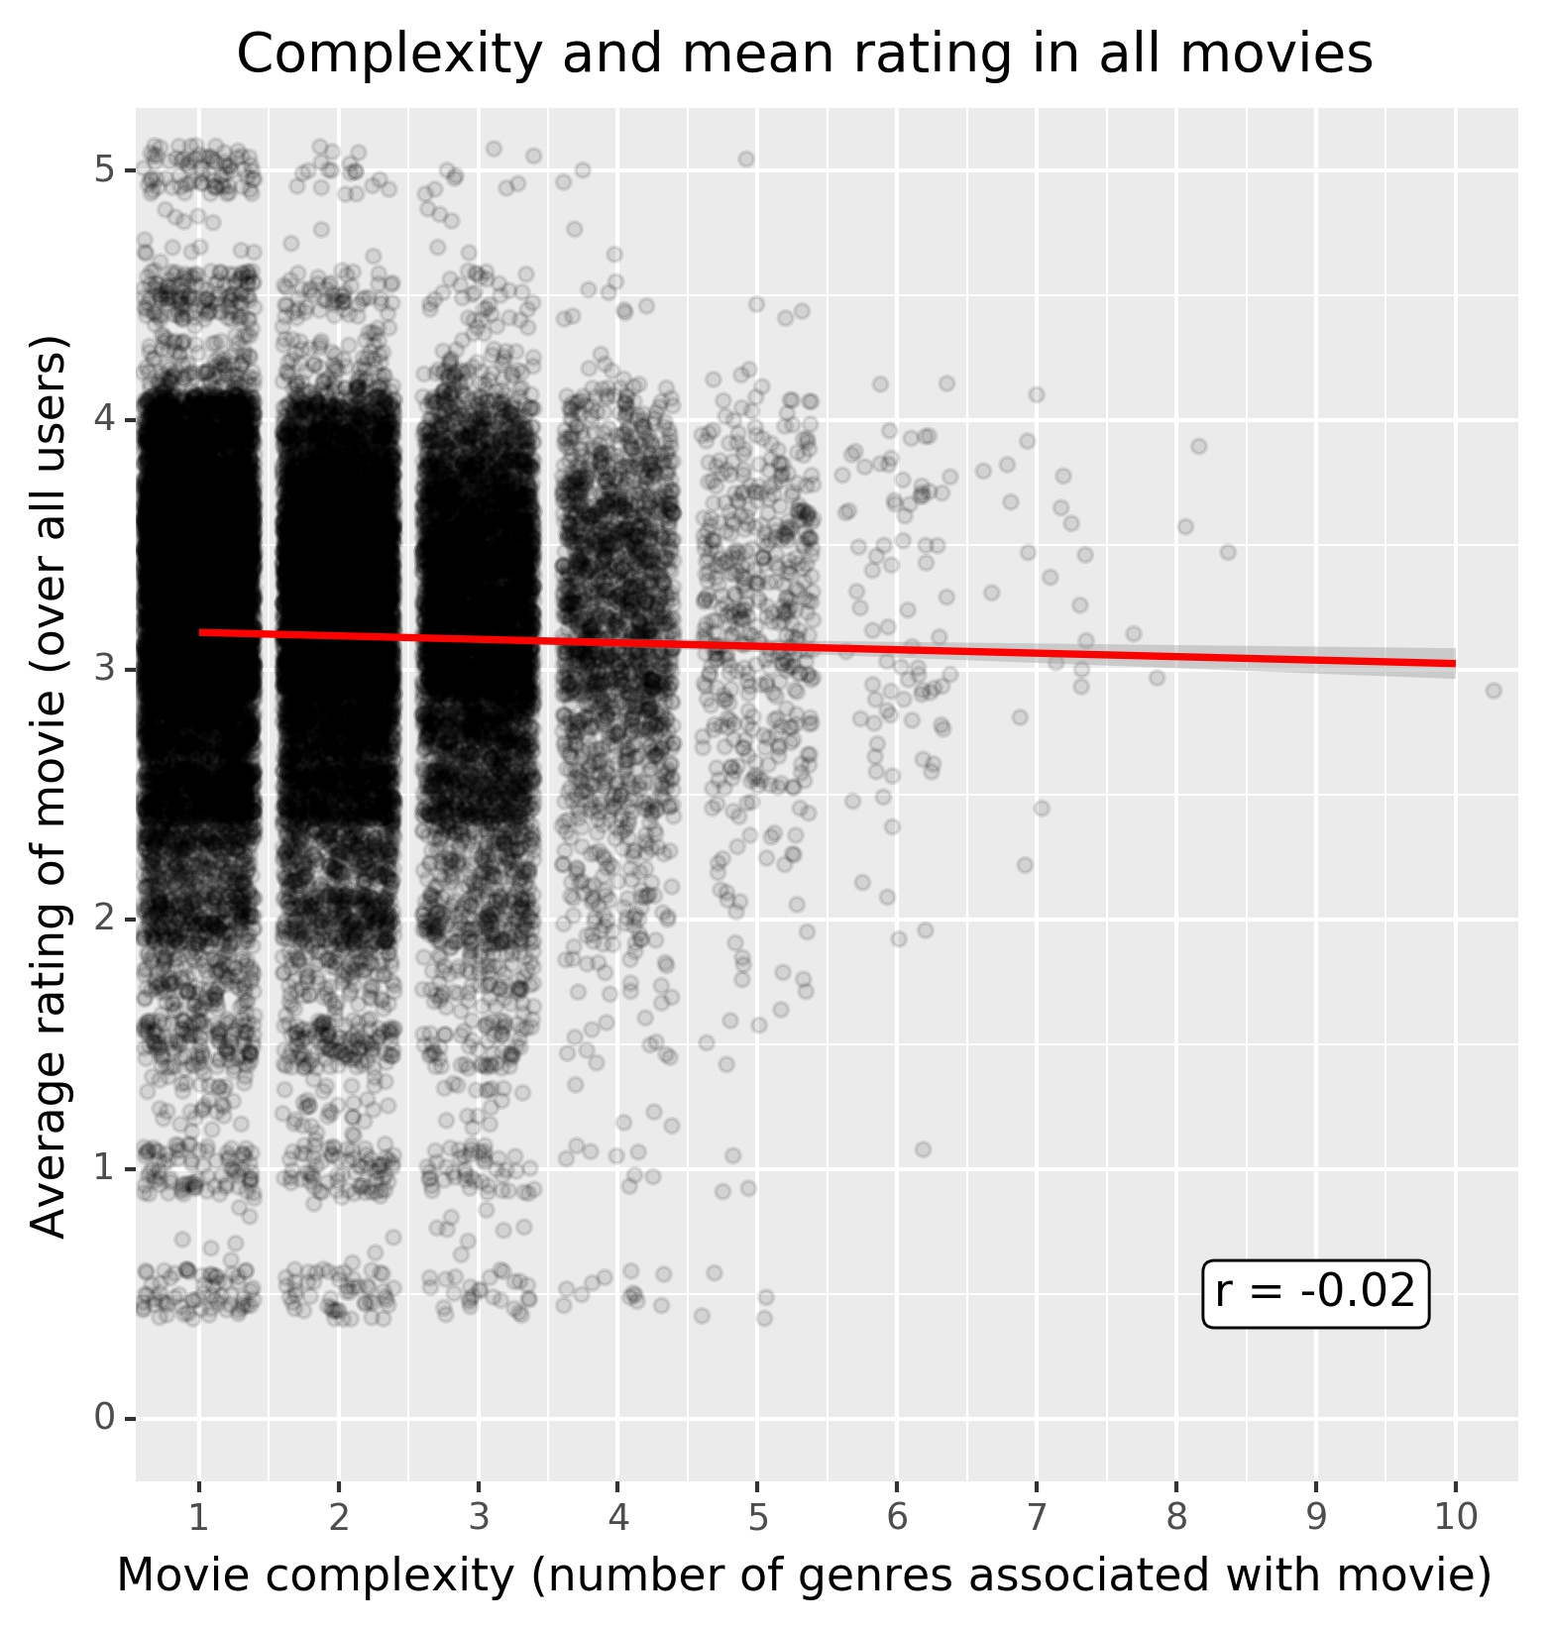
Findings
Overall, the hypothesis of a (linear) relationship between complexity and rating is not supported by data (Pearson correlation r = -0.02).
It seems that the variance of movie ratings varies with movie complexity:
Less complex moves have higher spread of ratings, ranging from 0.5 to 5.0.
More complex movies have lower spread of average ratings.
Figure: Movie ratings averaged over all users for each movie, complexity as measured by the number of genres indicated for each movie. Data is jittered to better show spread (random jitter added for ratings: ±0.1; for complexity: ±0.4). Red line depicts a linear regression model fitted to the data in the plot. Slope of line corresponds to correlation.

Slide 6
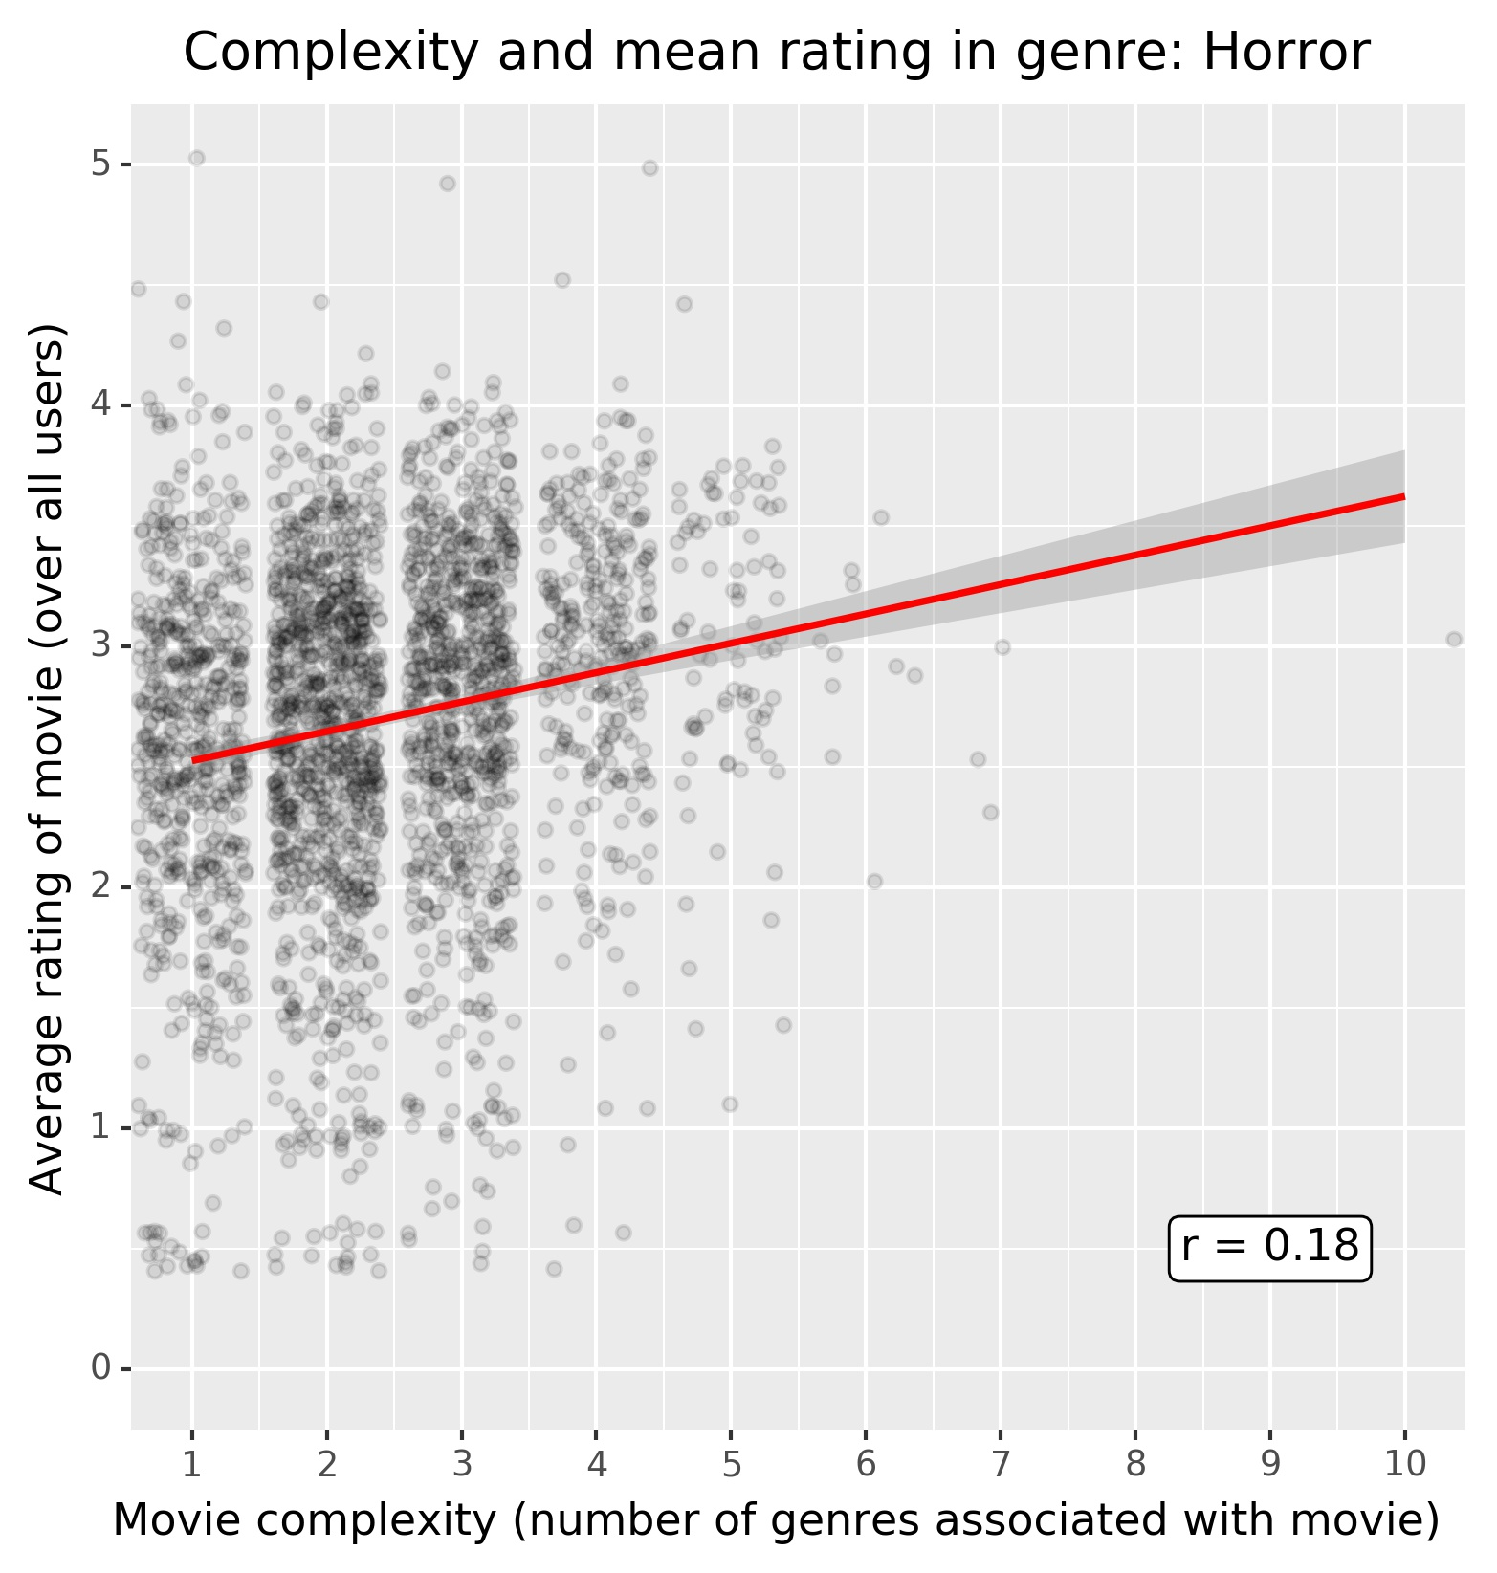
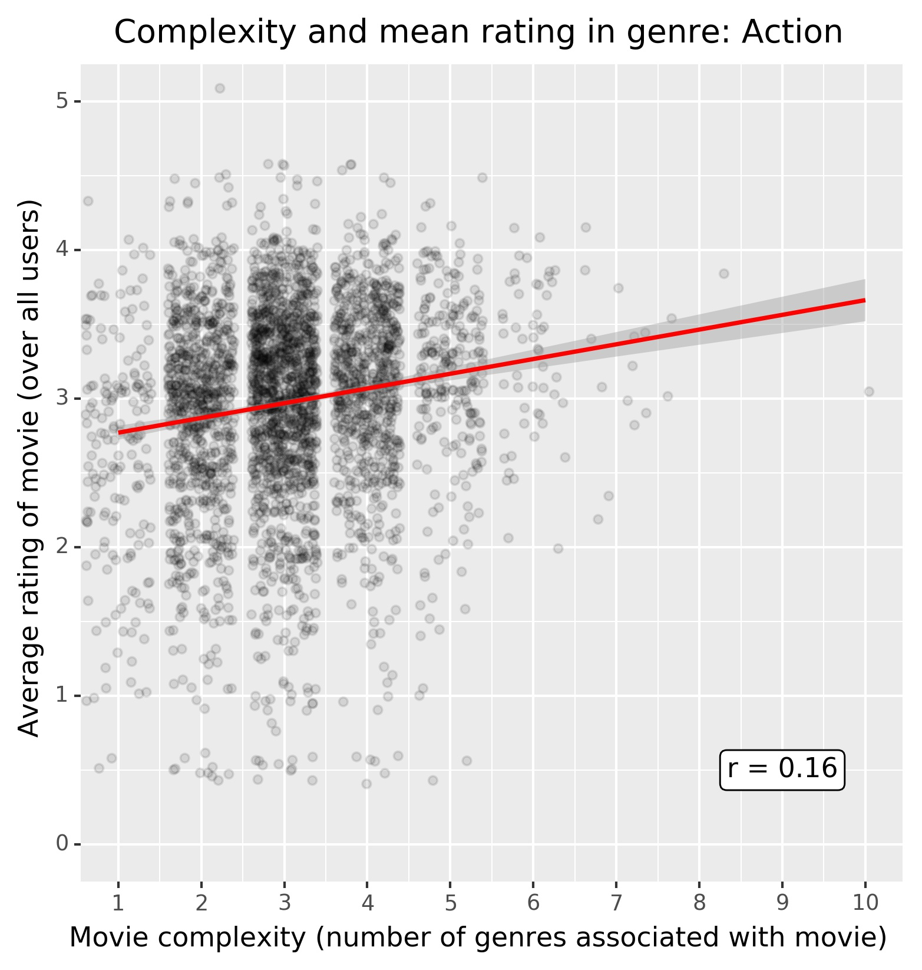
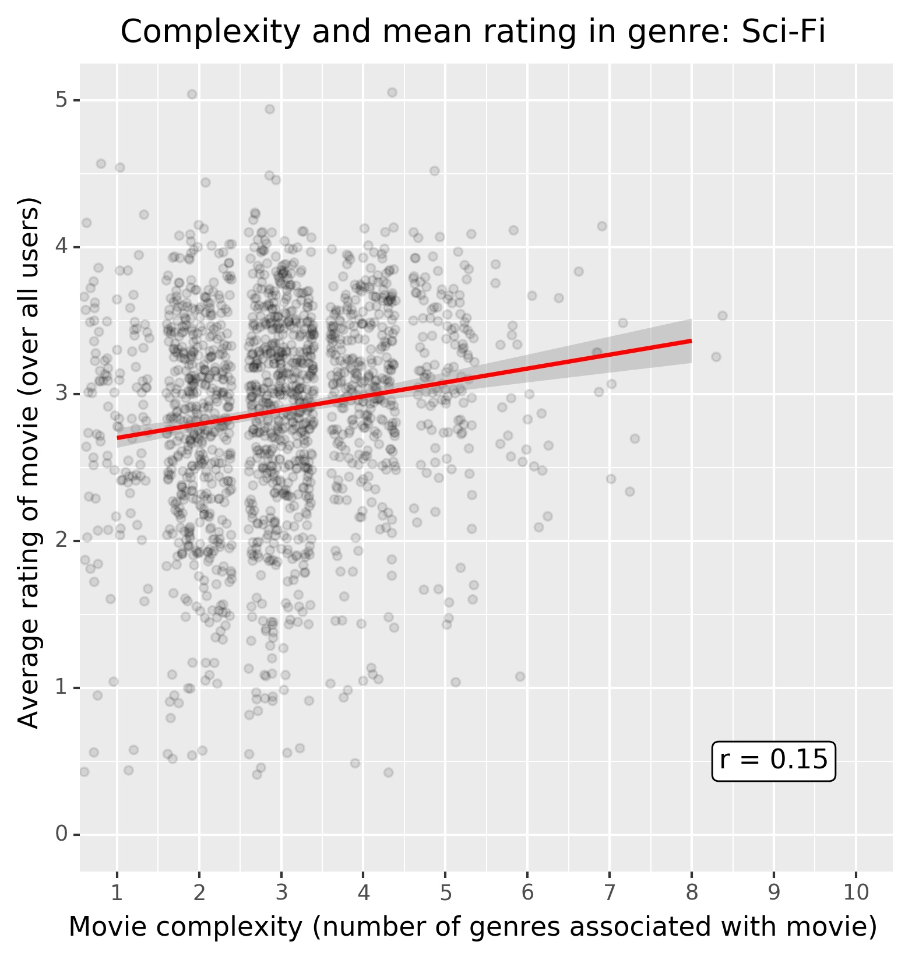
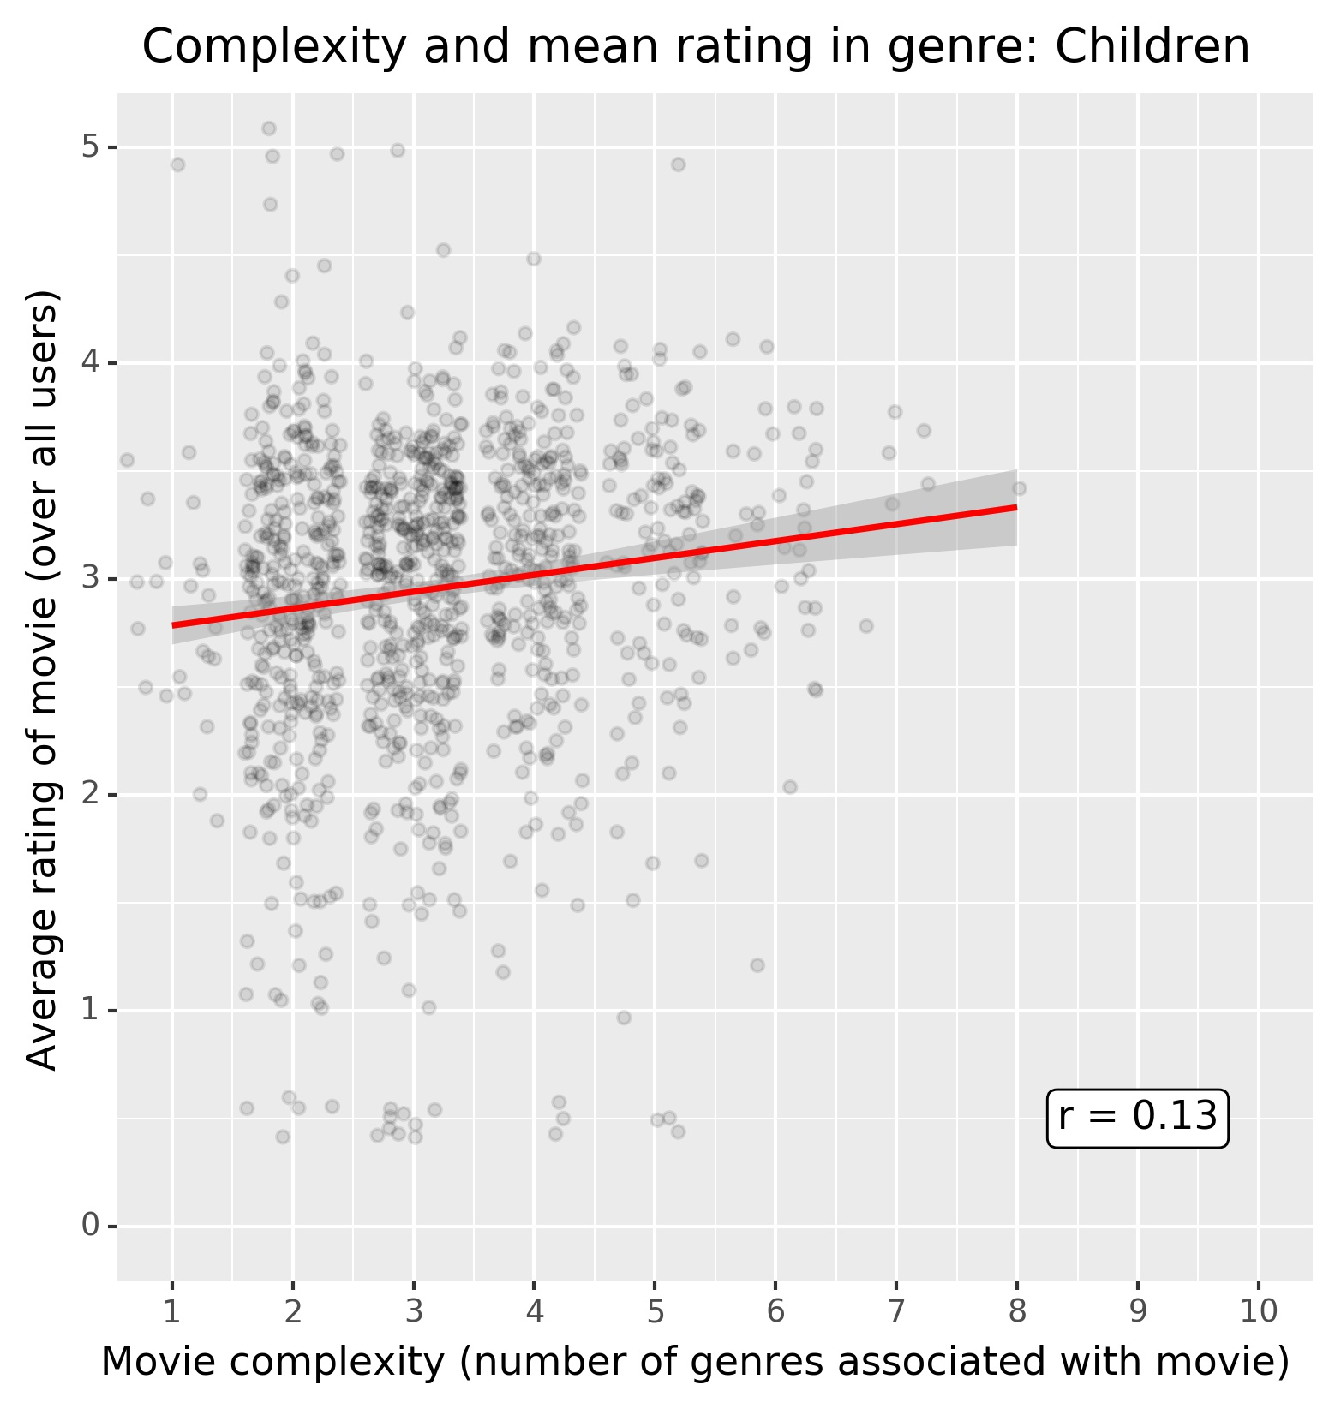
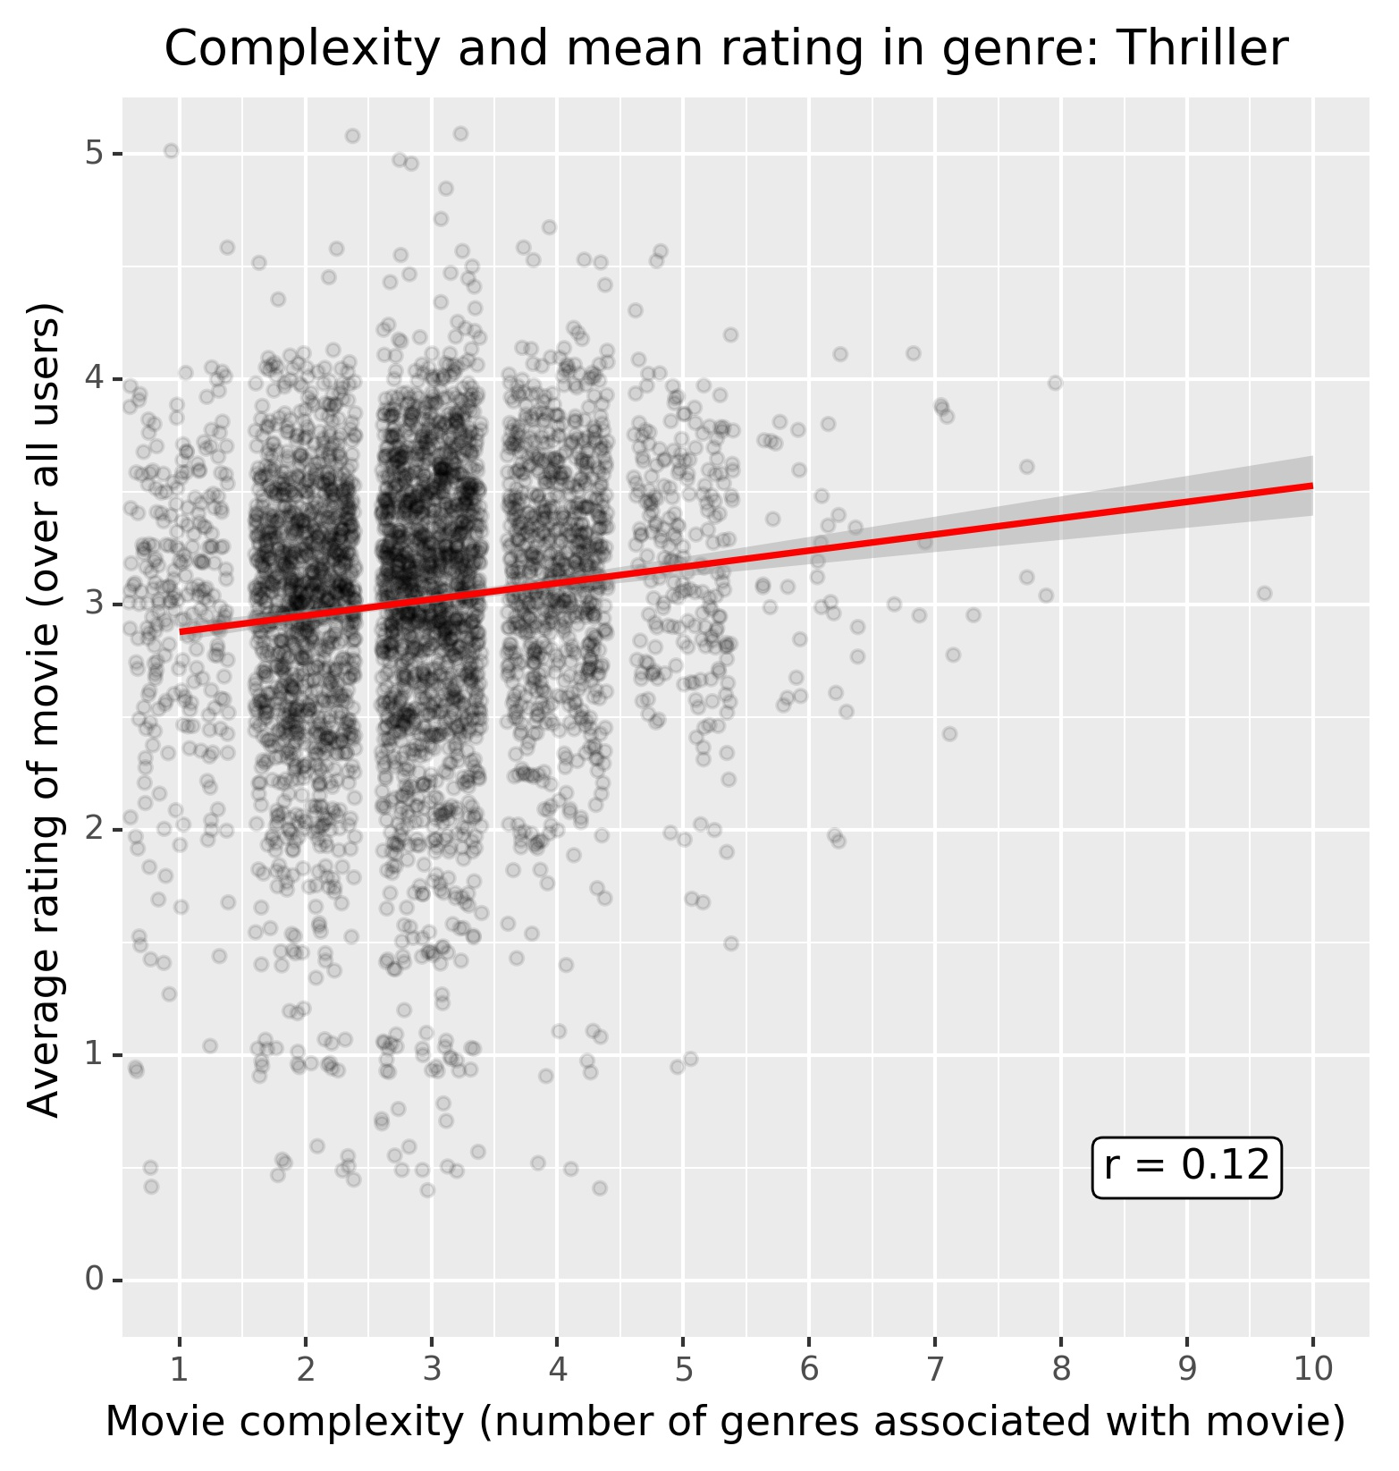
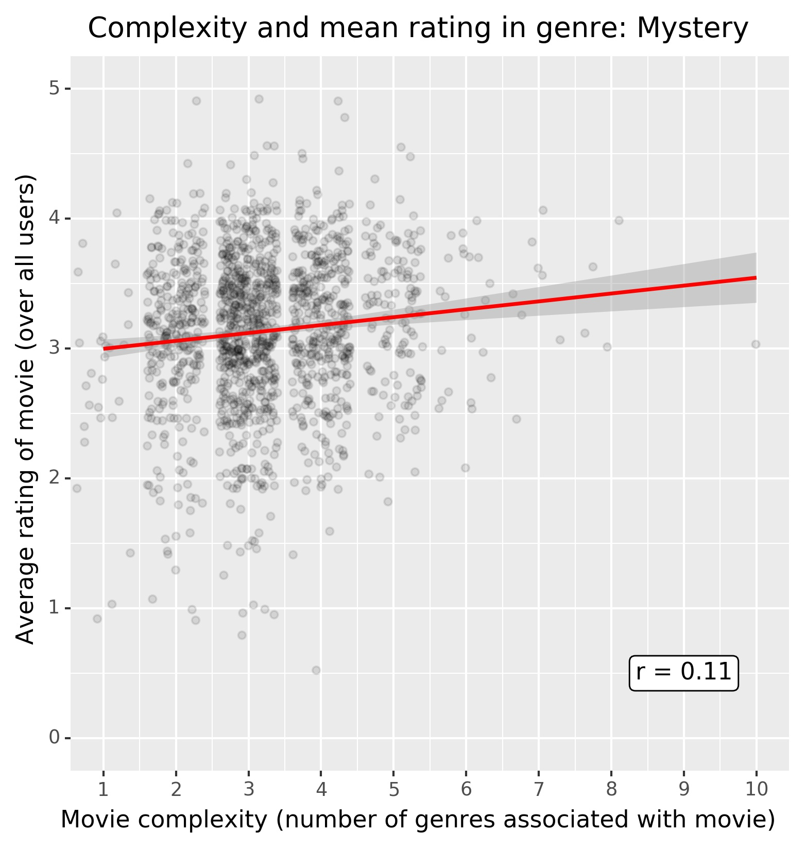
Findings
Genre | n | r
Horror | 2611 | 0.184
Action | 3520 | 0.161
Sci-Fi | 1743 | 0.150
Children | 1139 | 0.128
Thriller | 4178 | 0.118
Mystery | 1514 | 0.108
Animation | 1027 | 0.097
IMAX | 196 | 0.096
Comedy | 8374 | 0.092
Western | 676 | 0.090
Musical | 1036 | 0.059
Adventure | 2329 | 0.057
Romance | 4127 | 0.054
Crime | 2939 | 0.042
Fantasy | 1412 | 0.026
Film-Noir | 330 | -0.037
Drama | 13344 | -0.047
Documentary | 2471 | -0.058
War | 1194 | -0.063
Some genres show slight correlations of complexity and movie rating (higher complexity associated with higher ratings)
6 Genres have correlations greater than 0.10 (see table and figure on the right)
Highest correlation for the horror genre (r = 0.184)
Table: Pearson correlations (r) and sample sizes (n) within each genre subgroup. Each subgroup contains data of any movie that was associated with the respective genre (i.e., multiple plots might contain the same movie, if associated with multiple genres)
Figure: Movie ratings and complexity per genre. Each subplot contains data of any movie that was associated with the respective genre. As in main plot, data is jittered and the red line depicts a linear regression model fitted to the data in the plot. All subplots use the same axis limits for better comparability.

Slide 7
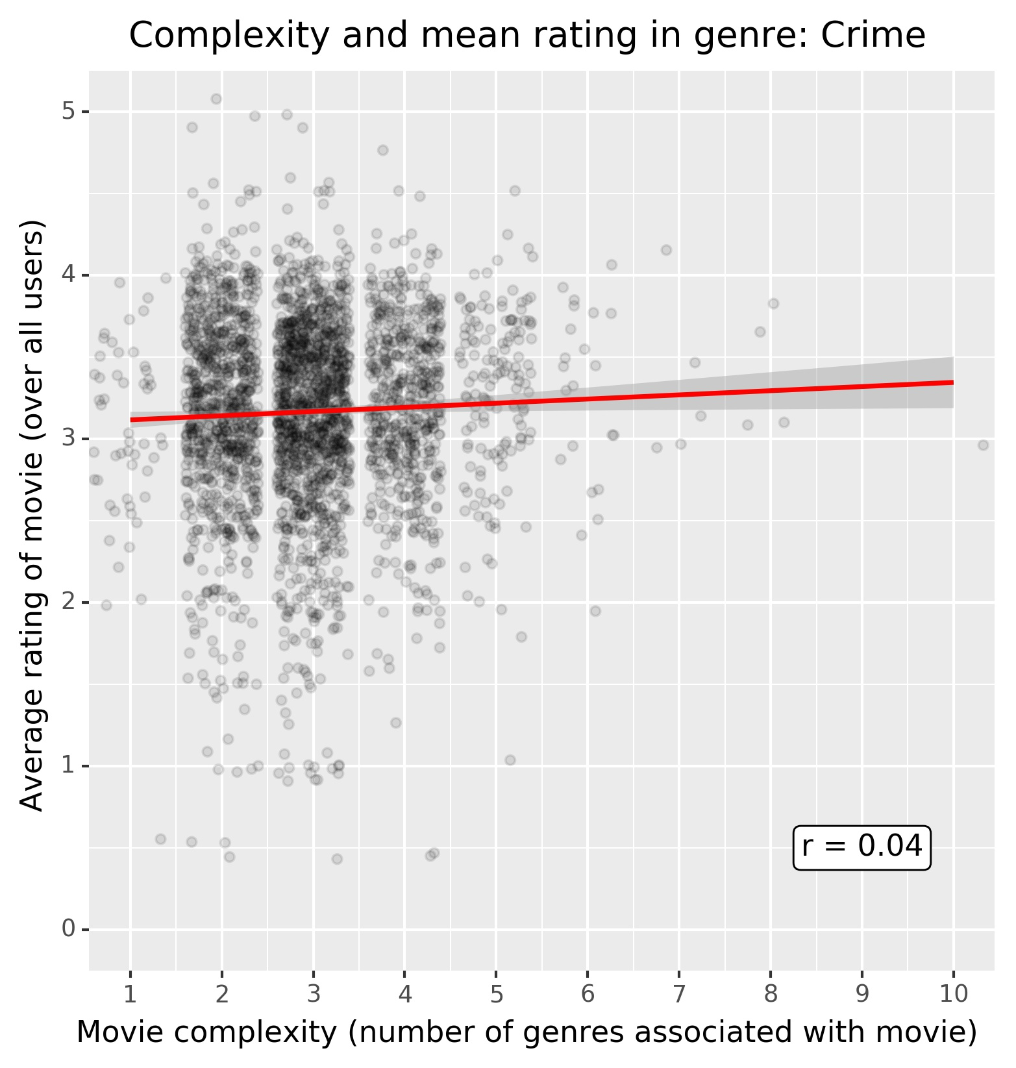
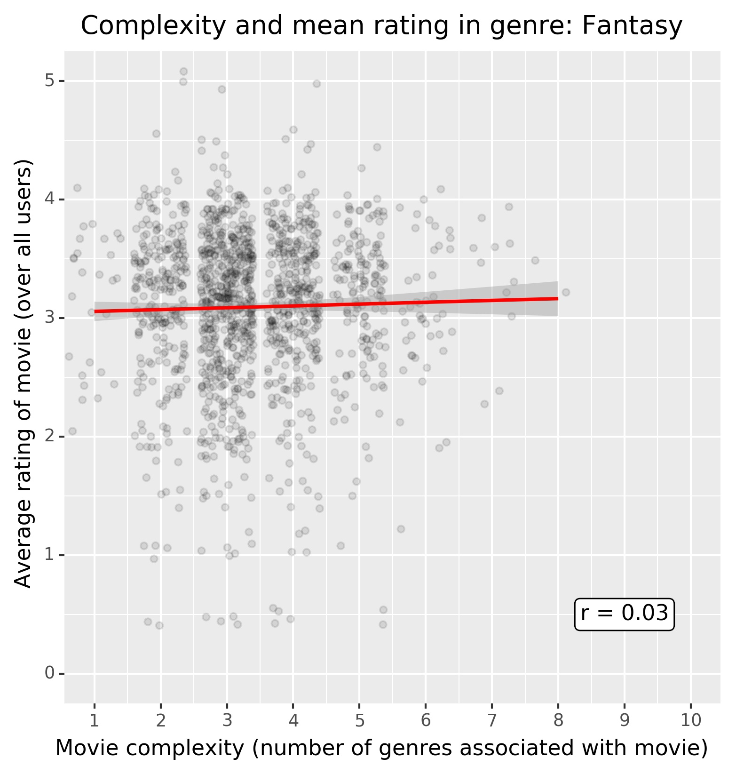
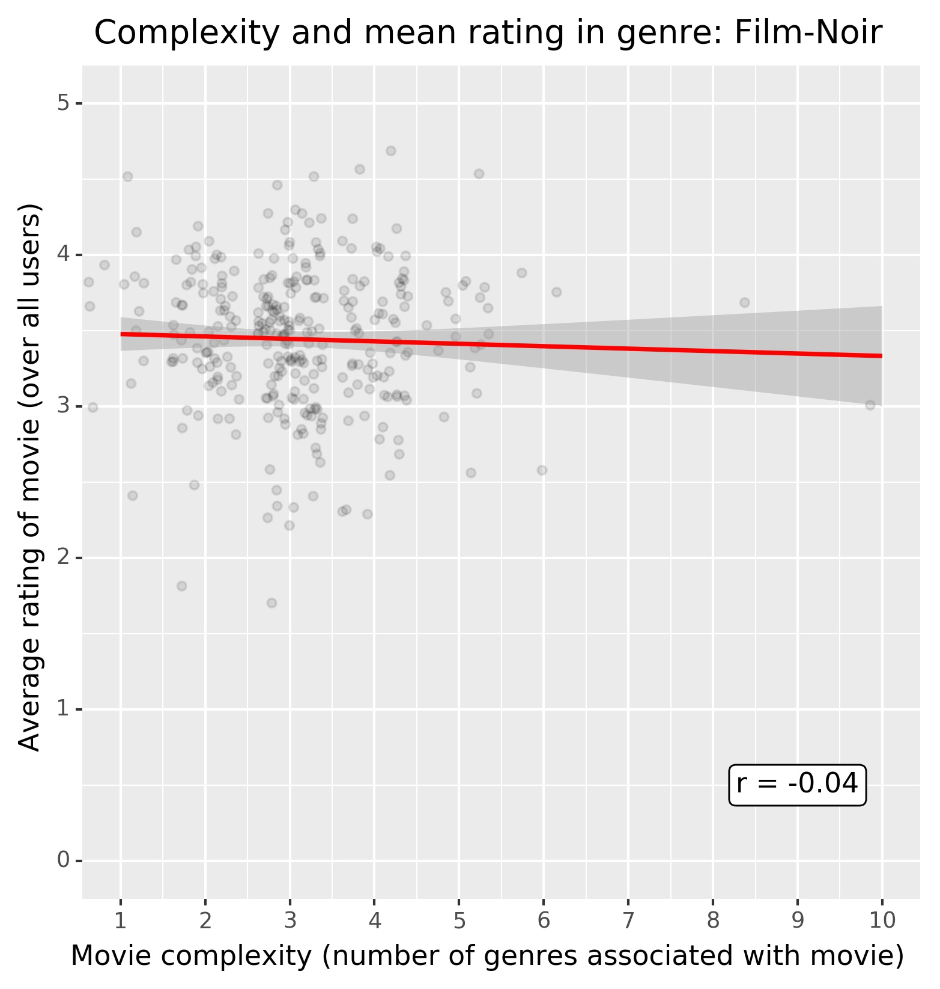
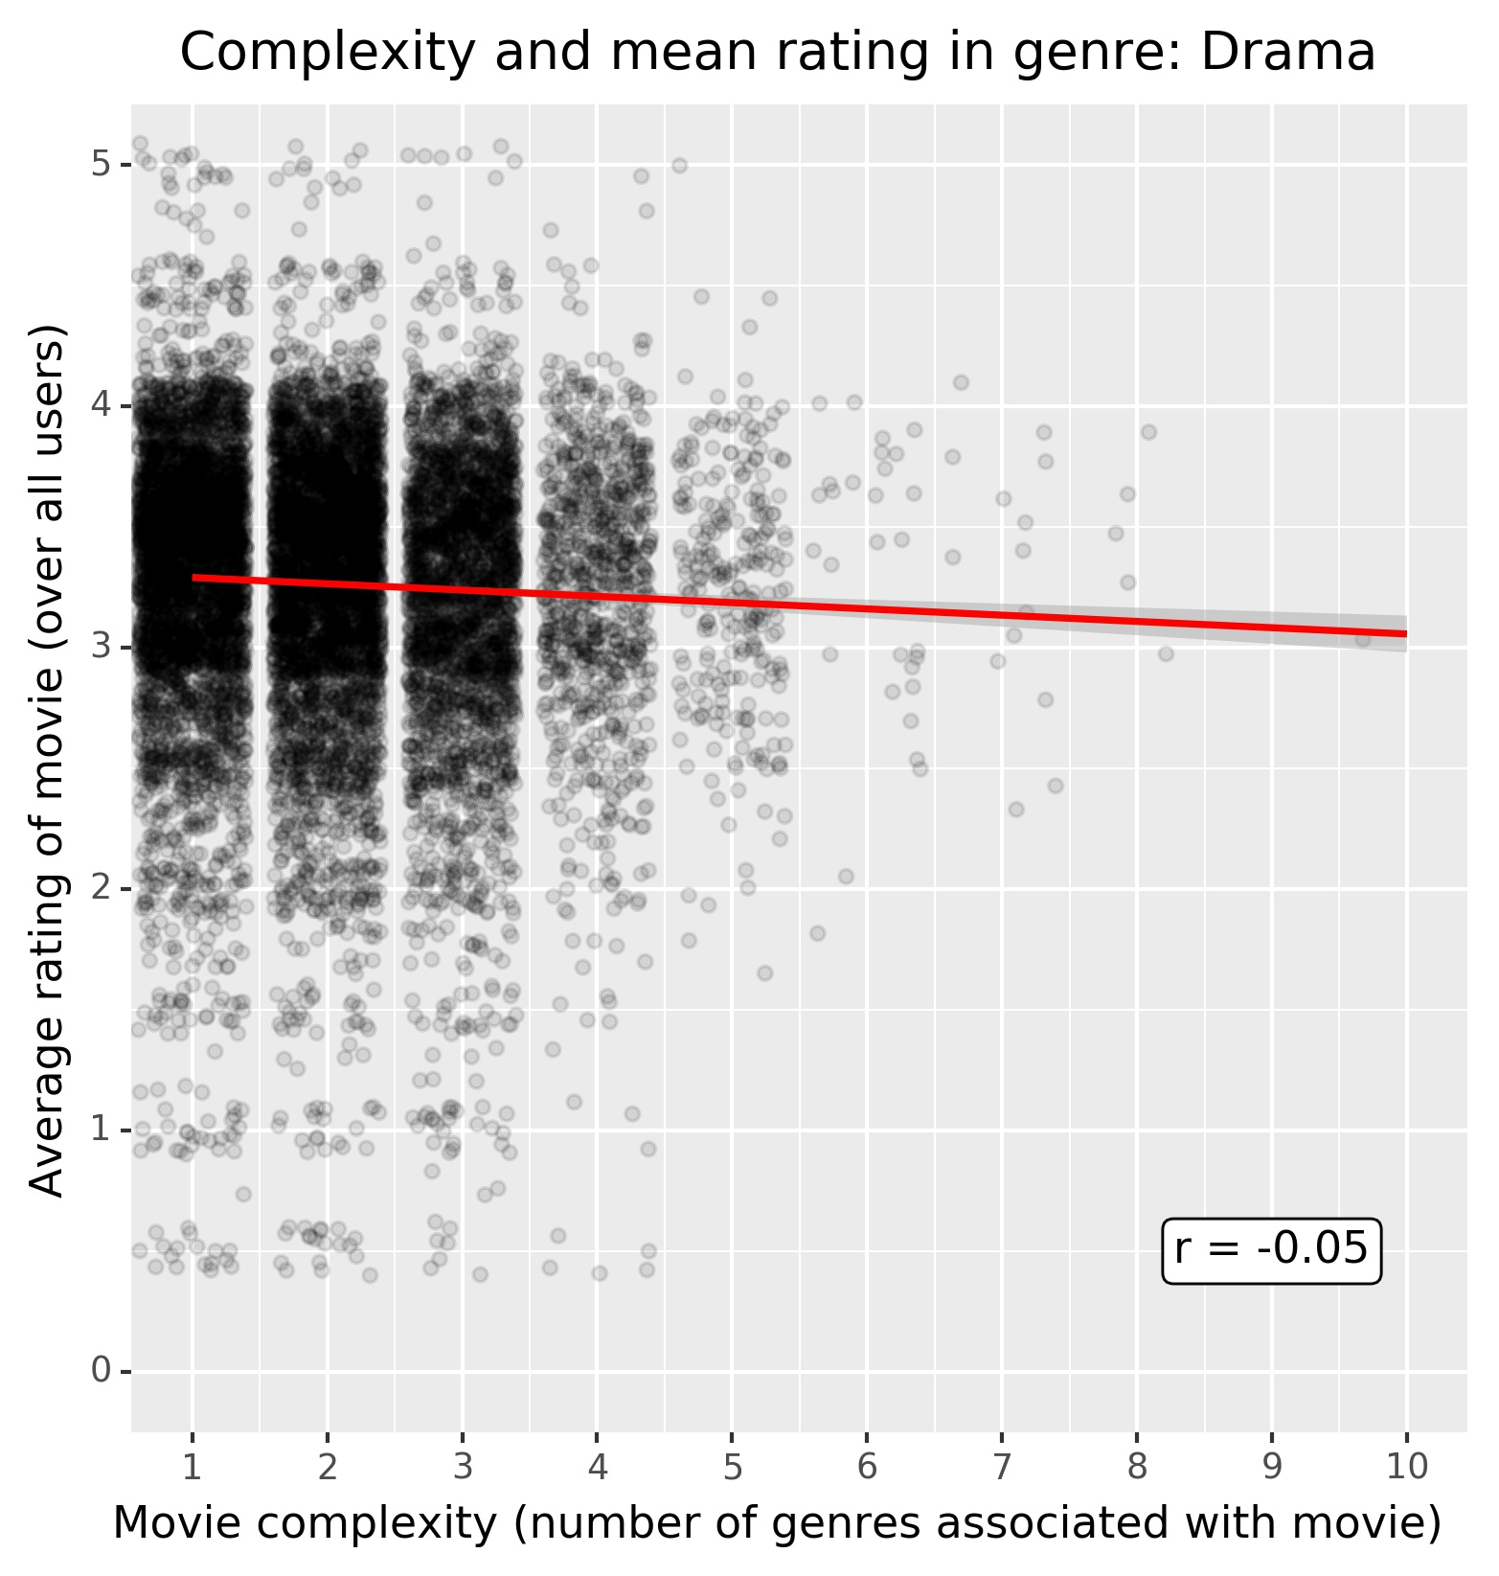
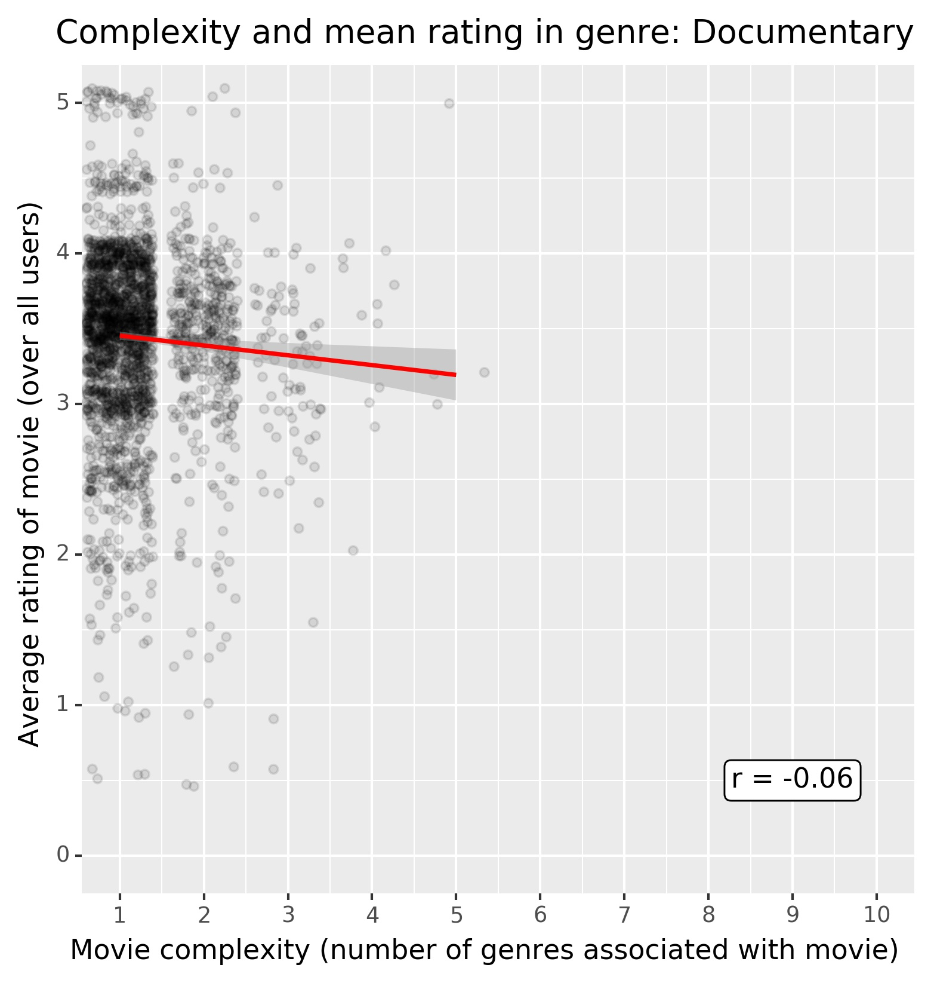
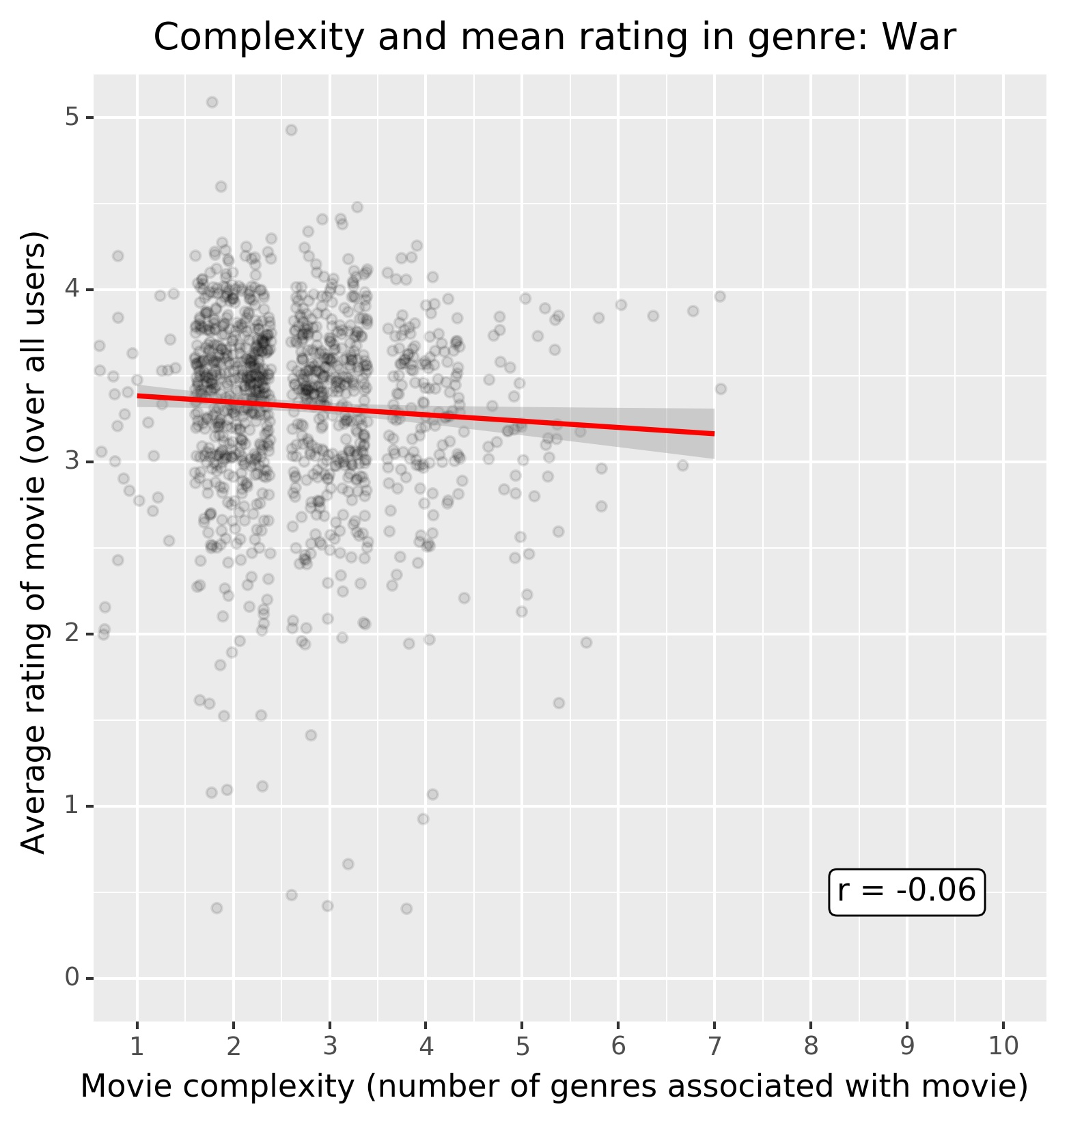
Findings
Most genres do not display any relevant correlation.
Of 19 genres:
11 genres have an absolute correlation of 0.10 or lower (|r| ≤ 0.10), explaining less than 1% of variance
4 genres have an absolute correlation of 0.05 or lower (|r| ≤ 0.05)
Some genres even show a negative relationship, even though with a very low correlation. e.g., war movies or documentaries (both r = -0.06, but both with a relatively small spread of complexity)

Slide 8
Findings and Conclusion
The data does not support the hypothesis for a general relationship of movie complexity and average rating (i.e., over all genres).
There is an indication for a relationship between variance of ratings and movie complexity. Movies with low complexity have a high spread of ratings (full range), while more complex movies have a lower spread (more towards the scale midpoint or slightly above).
Only some genres showed a (low) correlation between movie complexity and average ratings (e.g., horror, action, and sci-fi movies).
In summary, the hypothesis was confirmed only partially.

Slide 9
Appendix
Full analysis can be found on github: https://github.com/ingonader
Notebook containing this analysis (Jupyter notebook): https://github.com/ingonader/python-for-data-science-edx/blob/master/week-06-mini-project/imdb-movie-dataset-analysis-part-notebook.ipynb
Python file for full analysis (Jupyter lab): https://github.com/ingonader/python-for-data-science-edx/blob/master/week-06-mini-project/imdb-movie-dataset-analysis.py

